Slide 1
Quantum Climate Action
Climate Action Through Technology

Slide 2
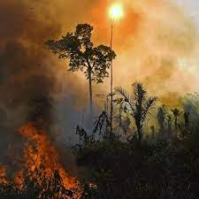
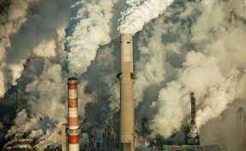
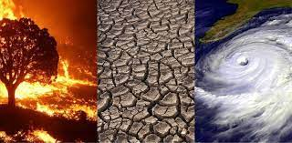
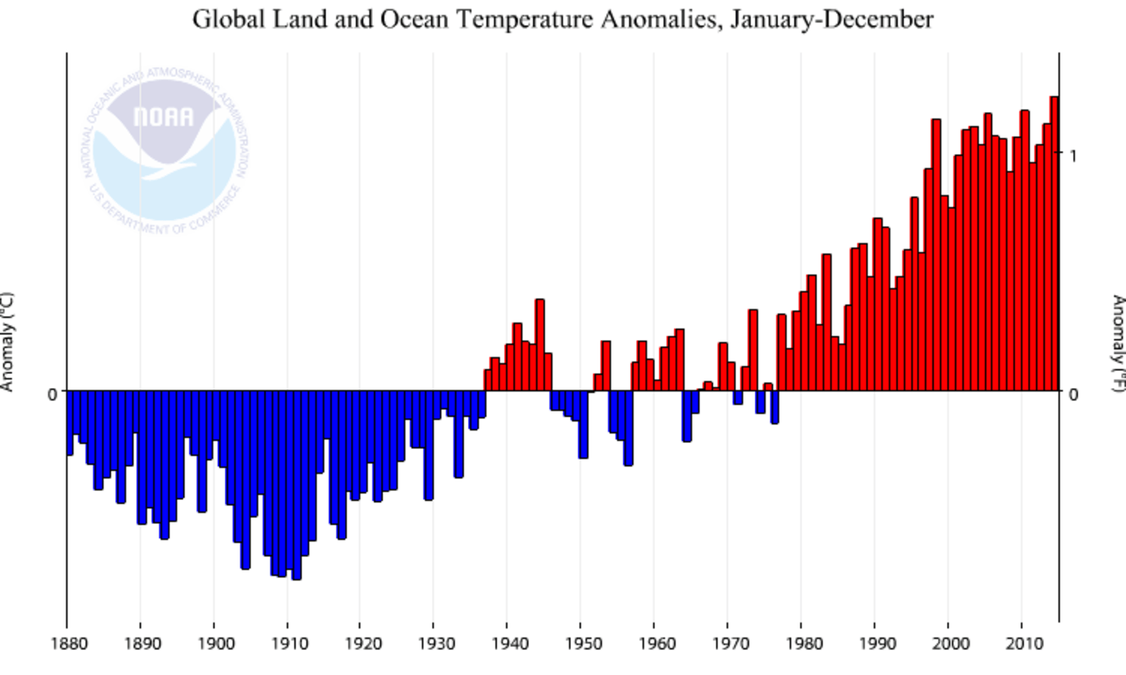
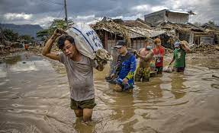
Our survival is being threatened
Wildfires
Increased storm activity
Flooding

Slide 3
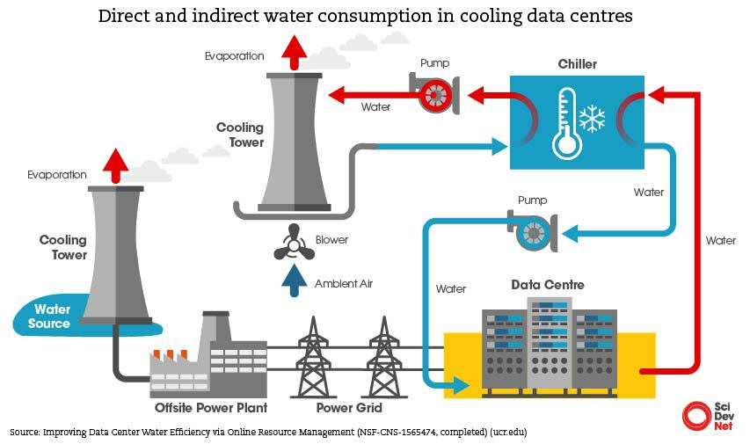
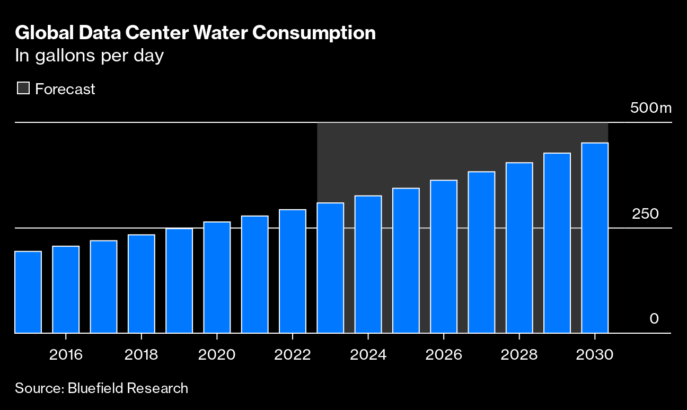
Electronic computing
Billions of litres of water are cooling computing servers every day.
Data centres expected to use 15% of global power within the next few years.

Slide 4
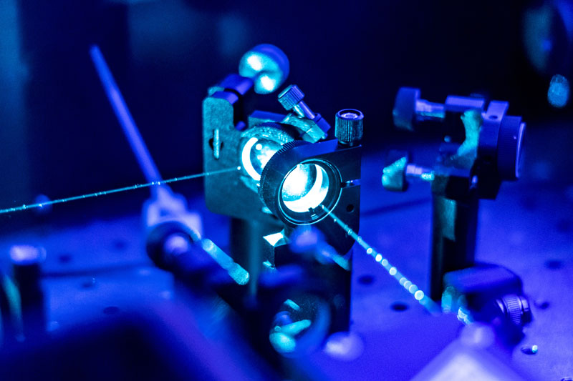
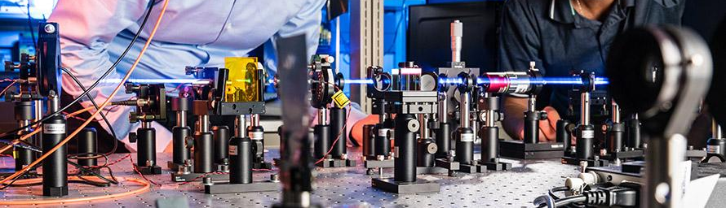

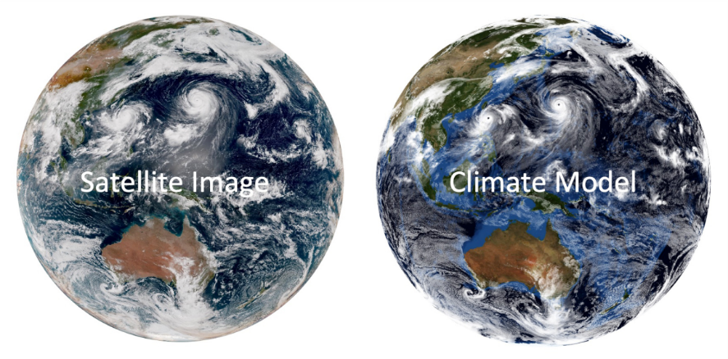
AIS: Advanced Simulation
Computing that offers unparalleled accuracy
Advanced simulations of climate prediction

Slide 5
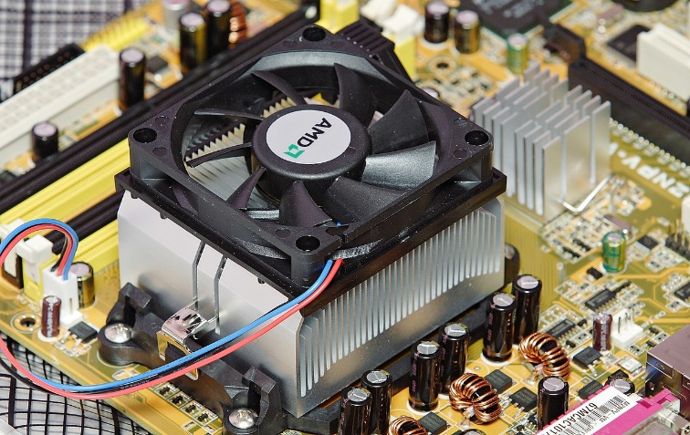
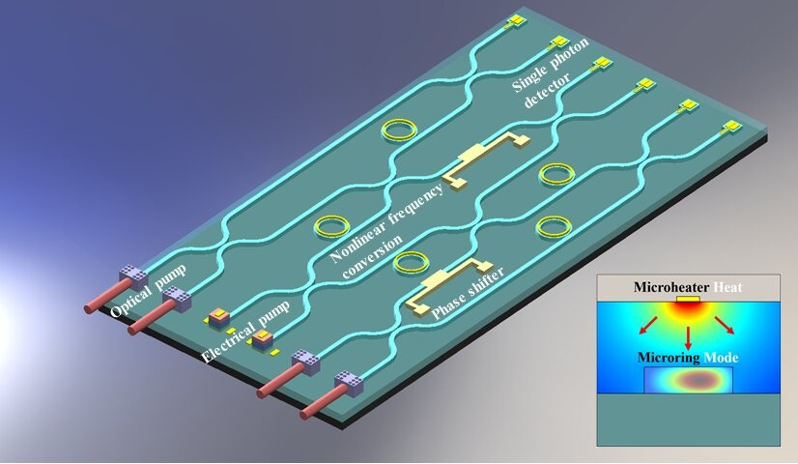
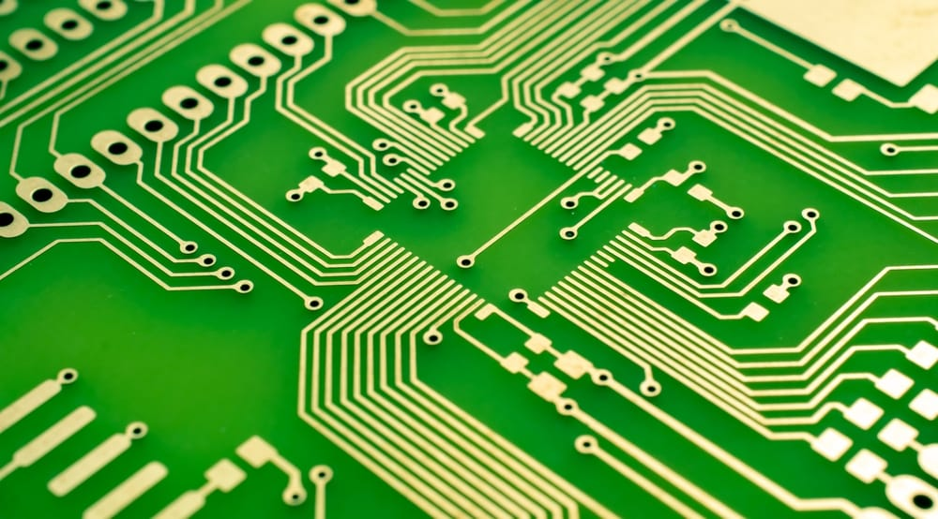
Key Differences
Photonic memory – new technology and IP.
Photonic computing – light speed, power efficient, cool.
Parallel and analogue computing – lends itself to Neural Networks.

Slide 6
Use Cases
It is assumed that the global emissions will remain the same; what does this mean for global temperature in 5 years time?
A new chemical process is looking to be commercialised; What is the effect of that product on the environment?
A large solar flare leaves the Sun towards Earth; What will the effect be?

Slide 7
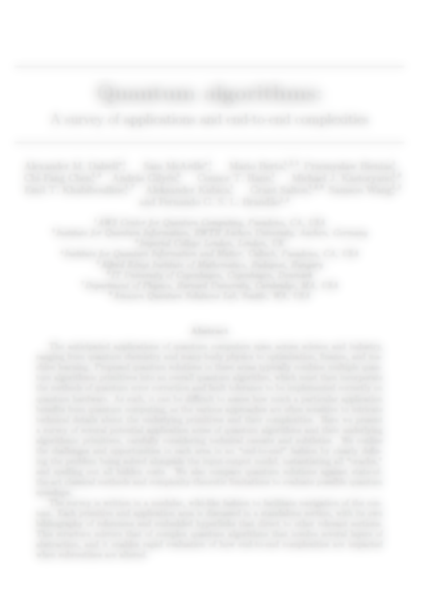
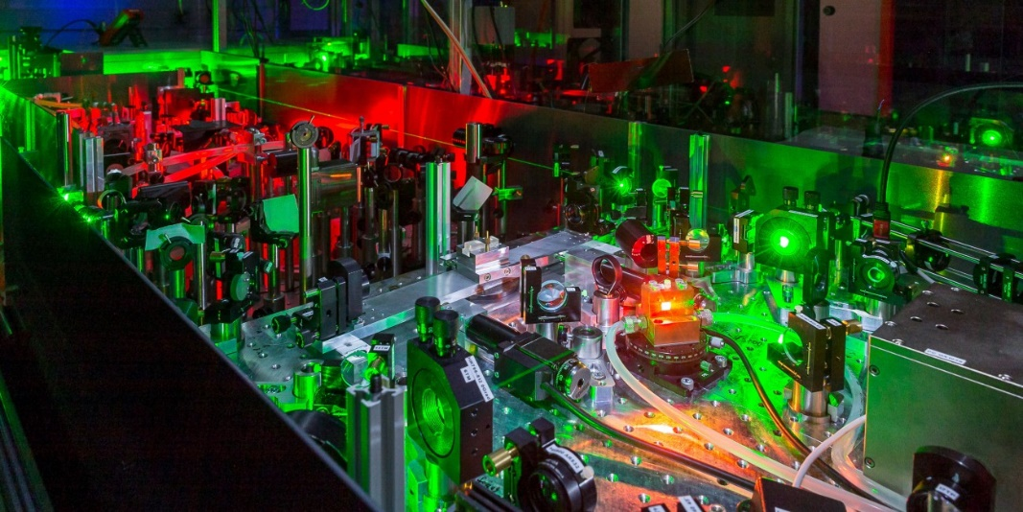
Technology
The technology used is taken from the latest quantum computing publications.
Designs and theories are both derived from publications and built on from a diploma course in optical engineering.

Slide 8
Next Steps
Funding call through first business use case
Request for £25,000 short term project.
Request for $3m for 24-24 month project
On-boarding of staff
Set up and use of optical software and optical lab.

Slide 9
Questions
For comments and questions:
Erik Clark
Mobile: +44 (0) 7879 958 118
Email: erik_clark@protonmail.com

